Slide 1
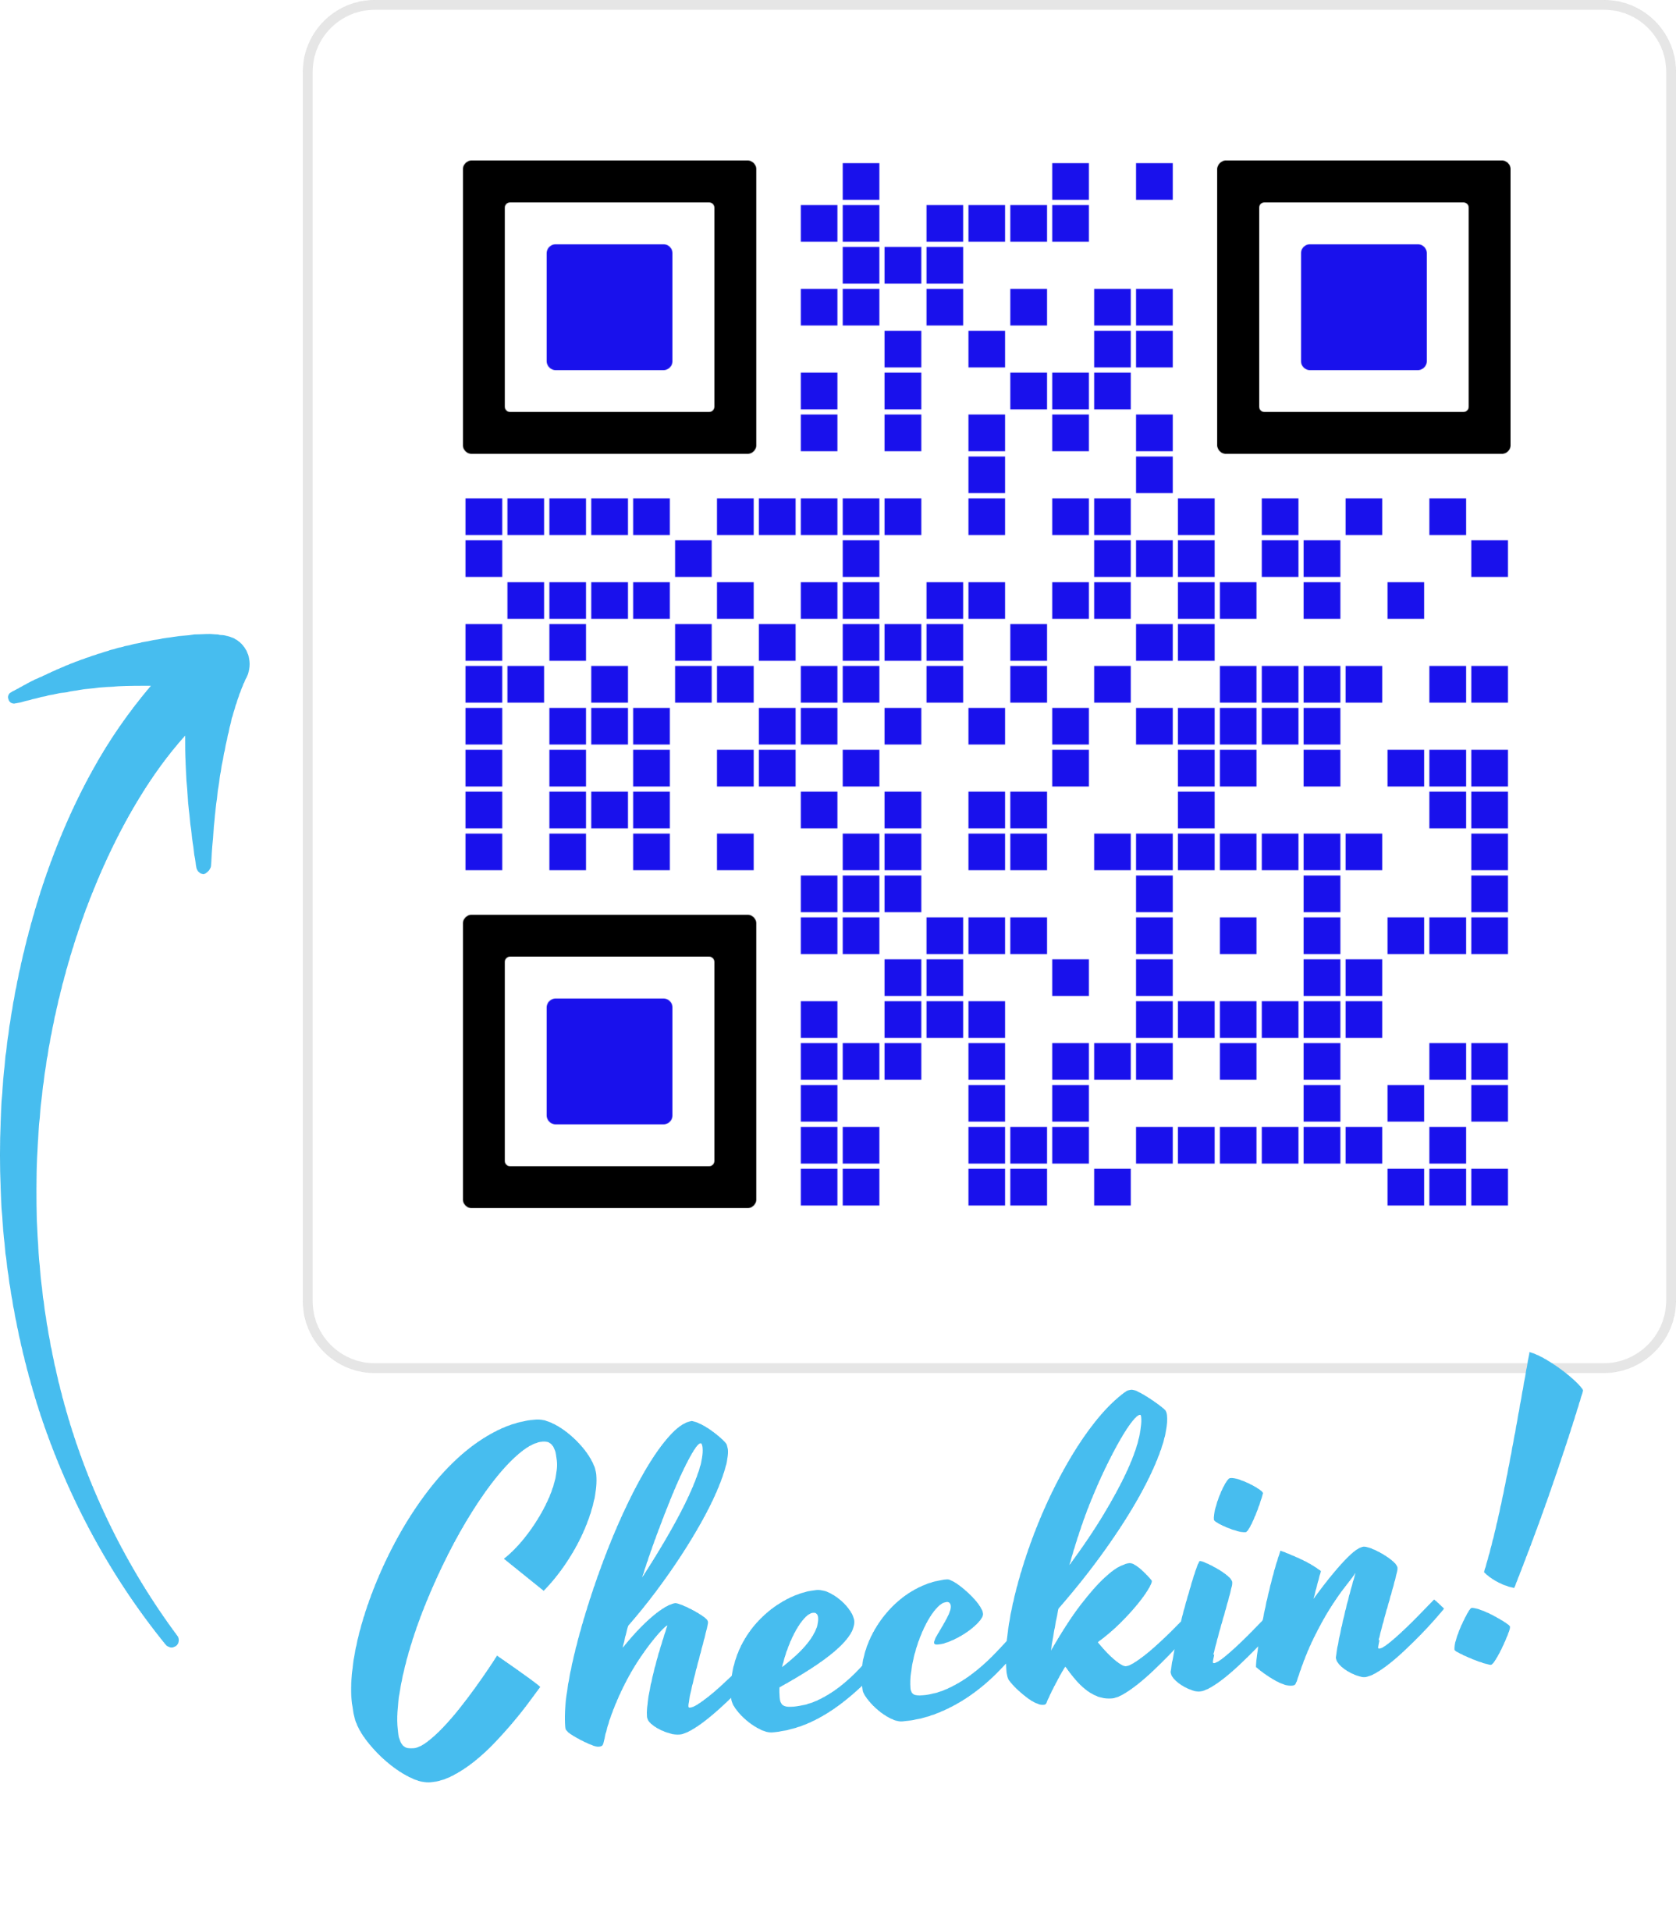
kubernetes training course – Oct 2022
author: viettq
Checkin

Slide 2
kubernetes training course – Oct 2022
author: viettq
Agenda
Review
Deployment
ReplicaSet
Working with Deployment and ReplicaSet
Practice
Summary

Slide 3
kubernetes training course – Sep 2022
author: viettq
REVIEW
Pod component: ApiVersion, Kind, Metadata, Spec
kubectl command with pod
kubectl run [pod-name] --image=[image-name] --port=[Port]
kubectl run [pod] --image=[image] --port=[Port] [--dry-run=client -oyaml]
kubectl get pods [-n namespace-name]
kubectl describe pod [pod-name] [-n namespace-name]
kubectl exec -it [pod-name] – [command] [-n namespace-name]

Slide 4
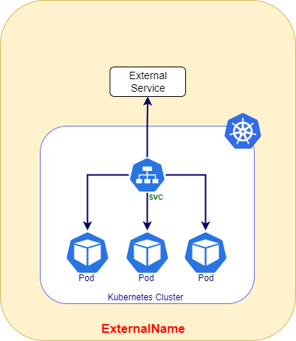
kubernetes training course – Sep 2022
author: viettq
kubernetes service

Slide 5
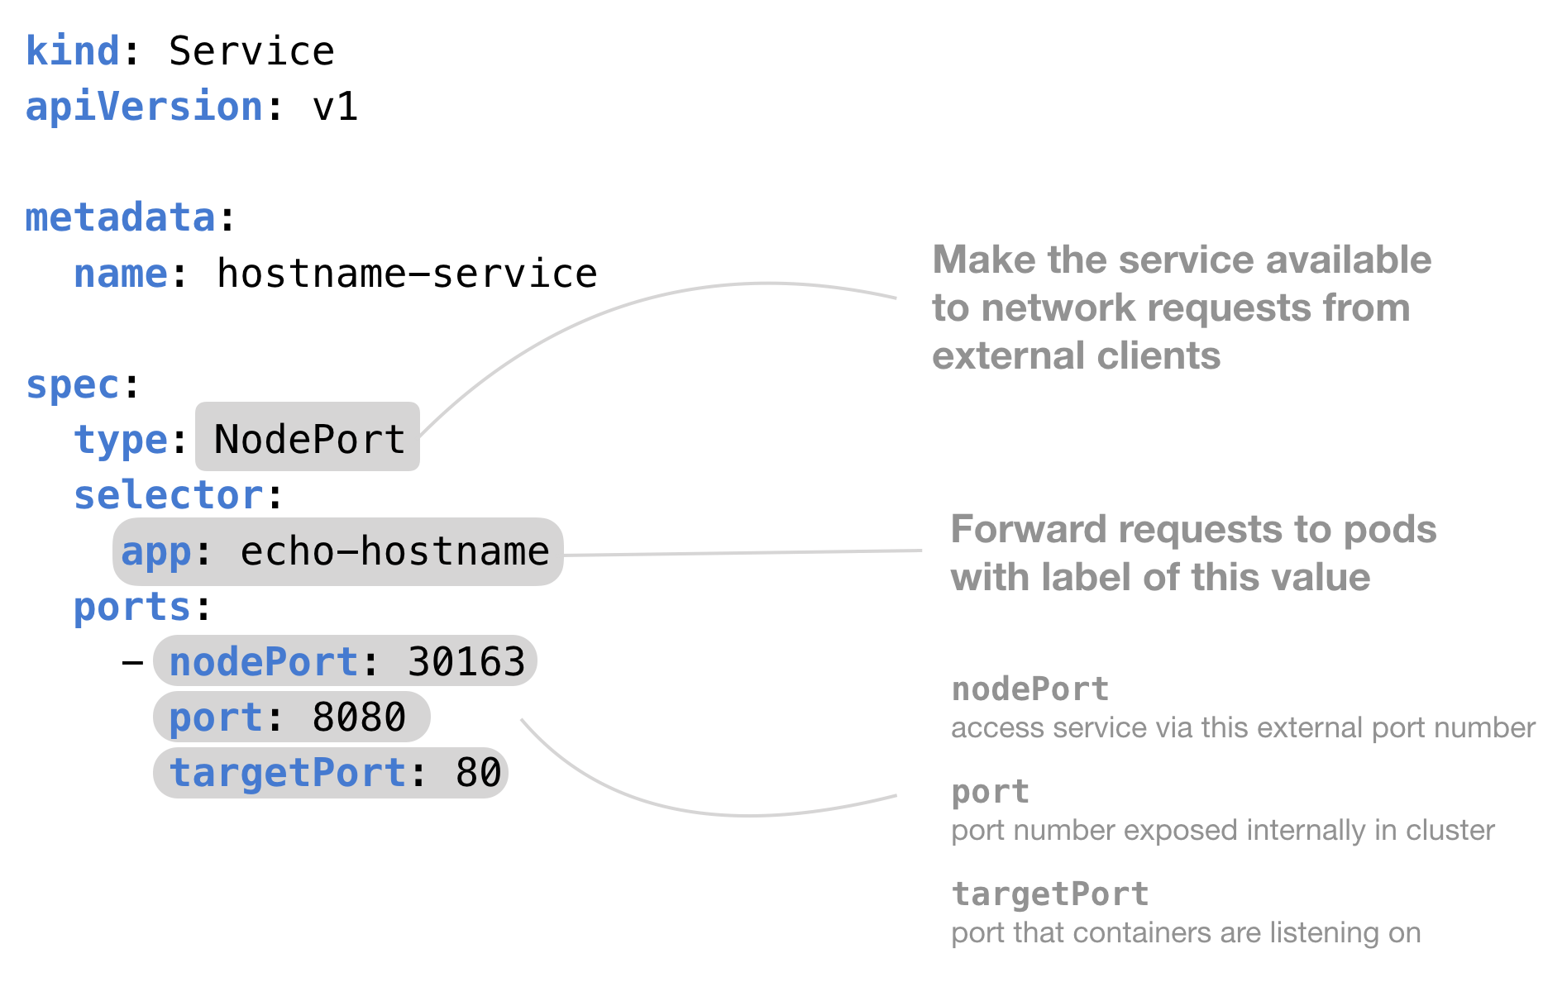
kubernetes training course – Sep 2022
author: viettq
Service components
kubernetes service

Slide 6
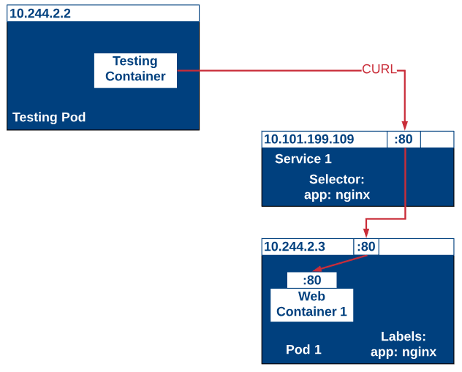
kubernetes training course – Sep 2022
author: viettq
Selector & endpoints
kubernetes service

Slide 7
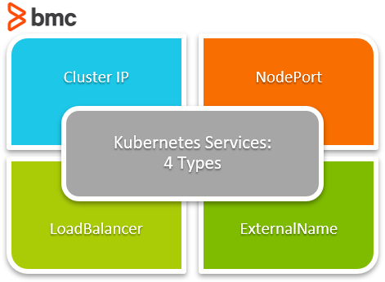
kubernetes training course – Sep 2022
author: viettq
Service types
kubernetes service

Slide 8
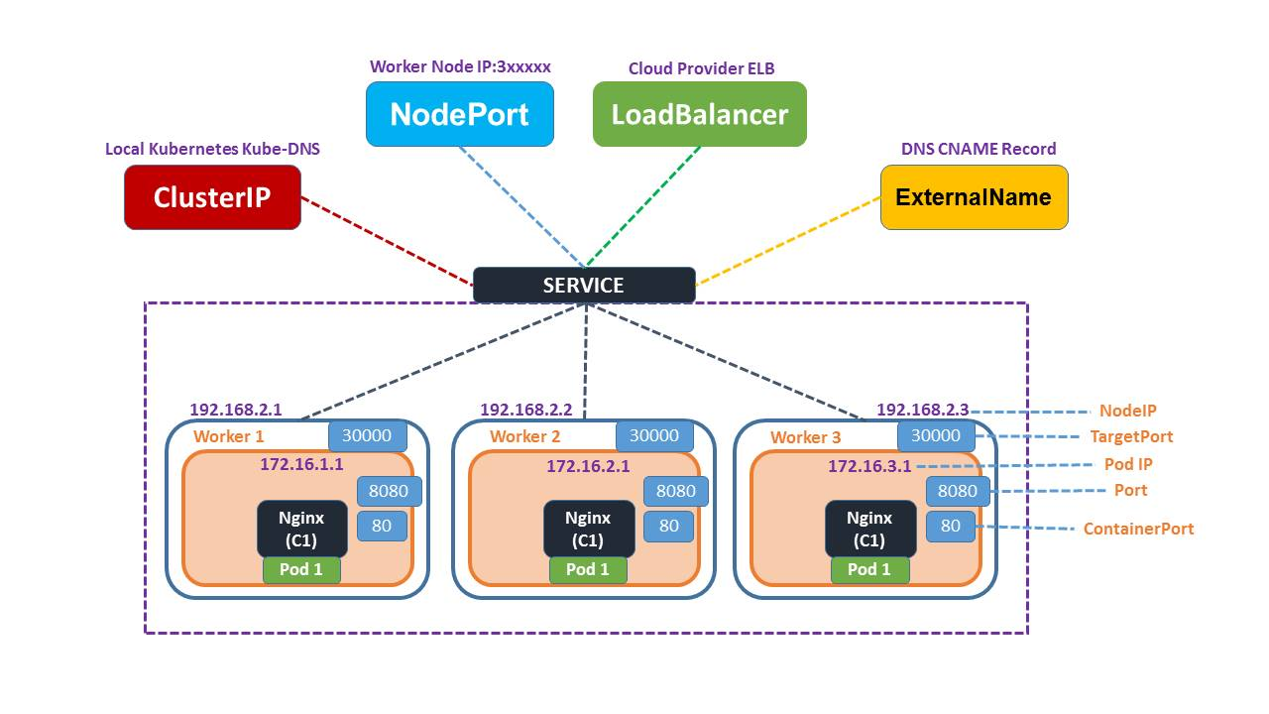
kubernetes training course – Sep 2022
author: viettq
Service types
kubernetes service

Slide 9
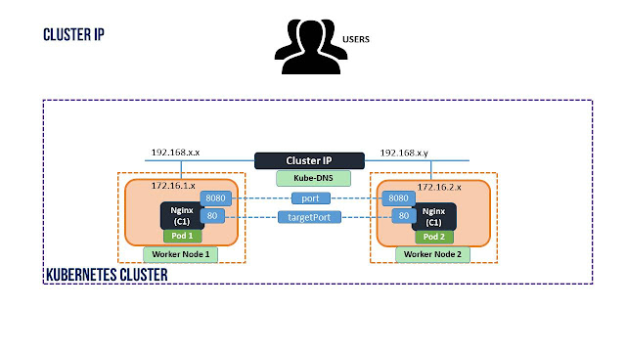
kubernetes training course – Sep 2022
author: viettq
clusterip
kubernetes service

Slide 10
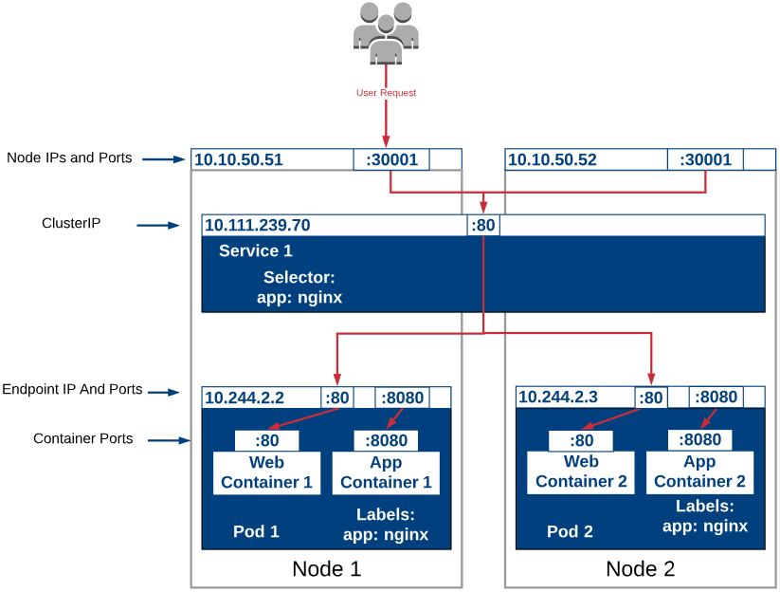
kubernetes training course – Sep 2022
author: viettq
Selector & endpoints
kubernetes service

Slide 11
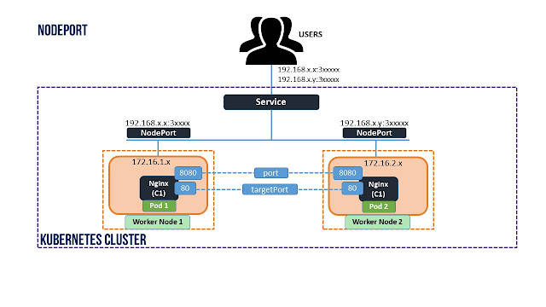
kubernetes training course – Sep 2022
author: viettq
nodeport
kubernetes service

Slide 12
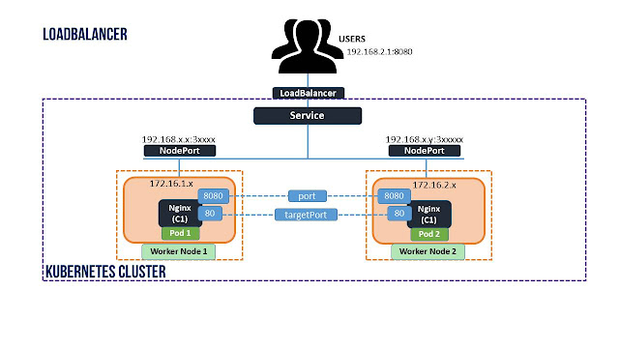
kubernetes training course – Sep 2022
author: viettq
loadbalancer
kubernetes service

Slide 13
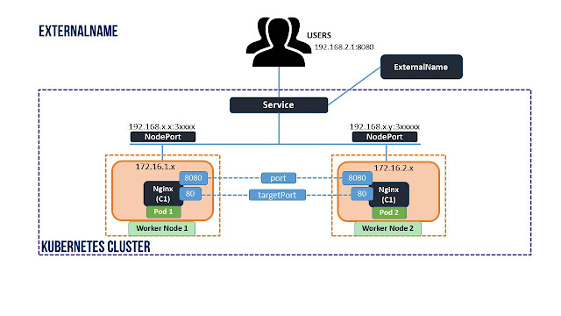
kubernetes training course – Sep 2022
author: viettq
externalname
kubernetes service

Slide 14
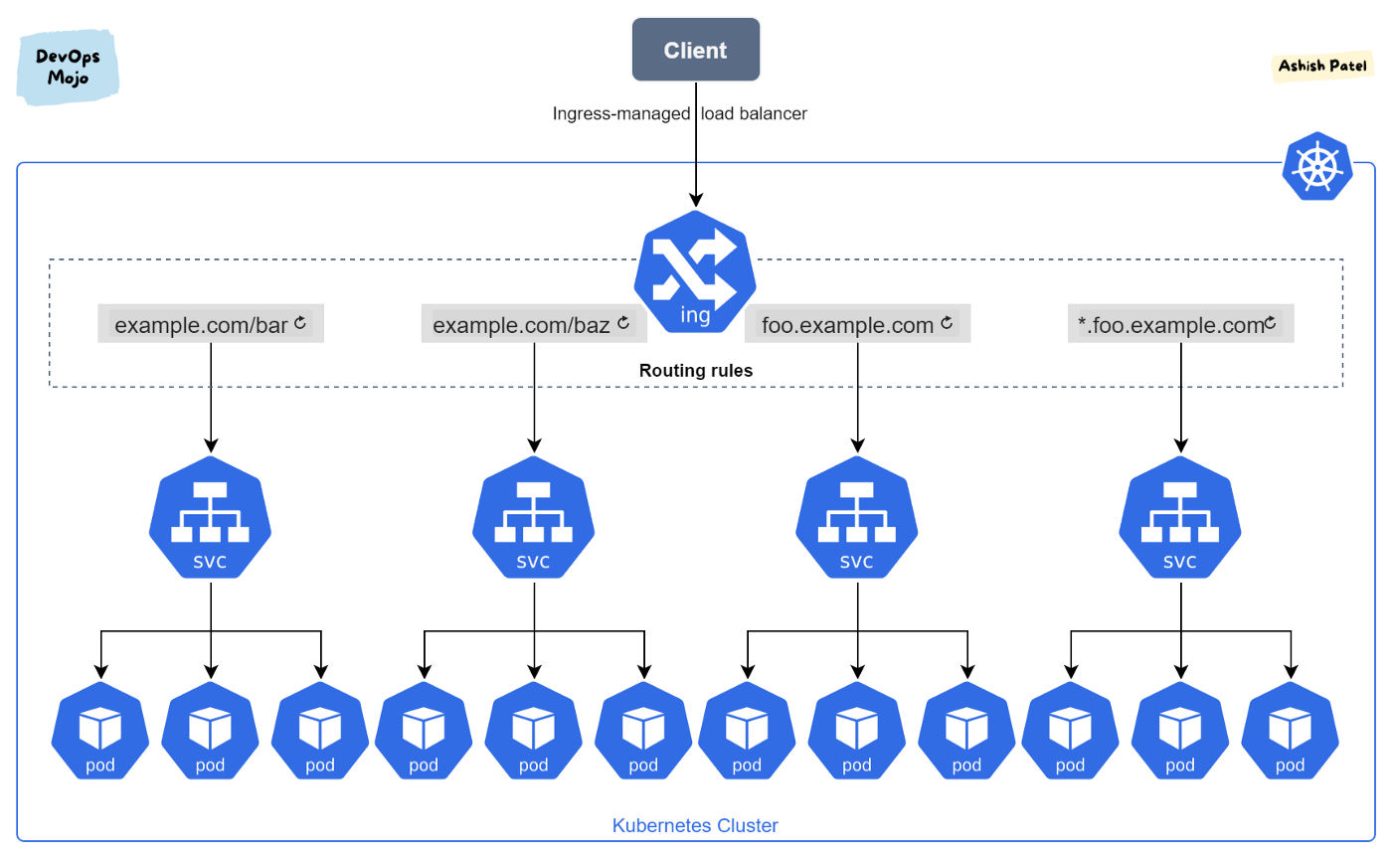
kubernetes training course – Sep 2022
author: viettq
kubernetes ingress

Slide 15
kubernetes training course – Sep 2022
author: viettq
.
Q&A
Ask me anything

